Slide 1
May 12, 2017
Get out Stuff for Notes
India/Pakistan Partition Notes
Late Work due Monday
Test Tuesday
Vocab & Notes due Tuesday

Slide 2
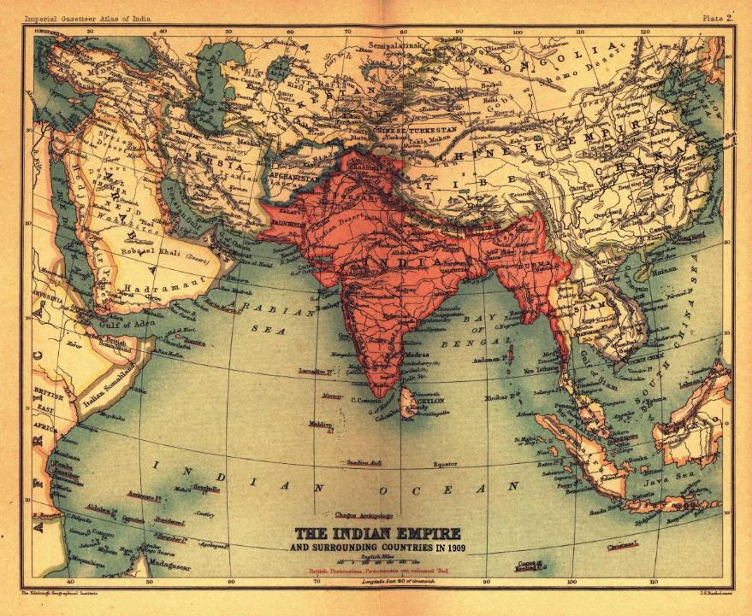
British India consisted of the modern countries of India, Pakistan, Bangladesh, and Myanamar.

Slide 3
India was known as the “Jewel in the Crown” of the British Empire.
It was also referred to as the British Raj.

Slide 4
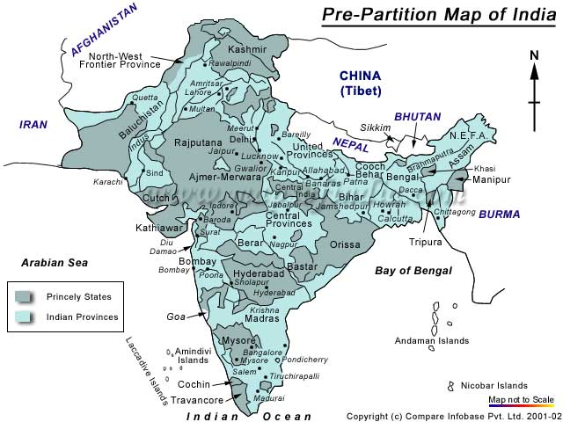

Slide 5
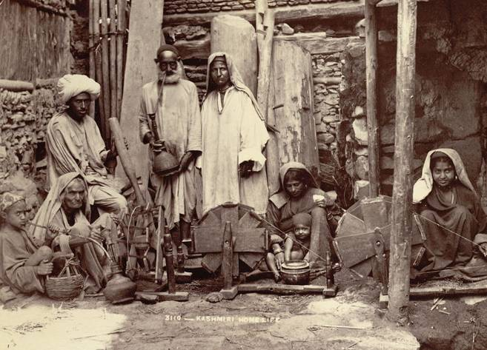
Society in British India
British officials and maharajahs lived in luxury
Majority of citizens lived in poverty

Slide 6
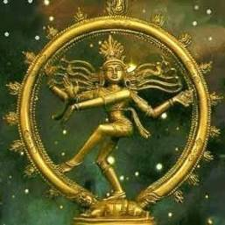
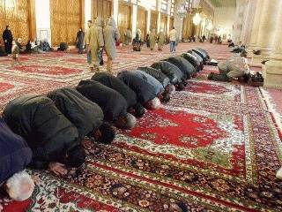
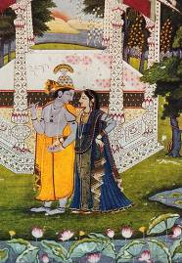
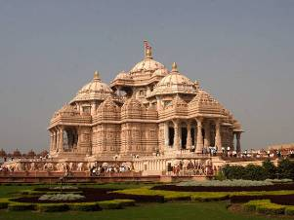
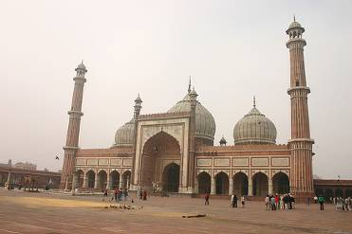
Hindu (majority)
Muslim (minority)

Slide 7
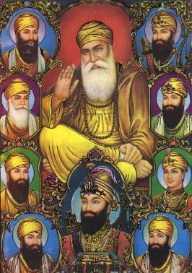
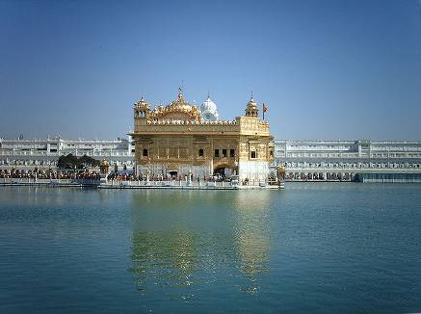
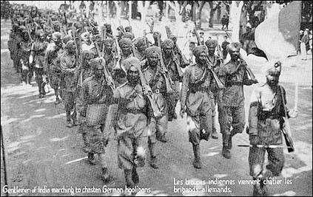
There were also a number of Sikh people in India who tended to side
more with the Hindus rather than the Muslims.

Slide 8
Religions in British India
Pink – Hindu
Green – Muslim
Yellow – Buddhist

Slide 9
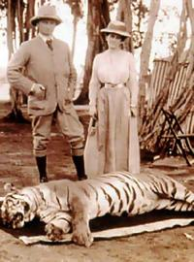
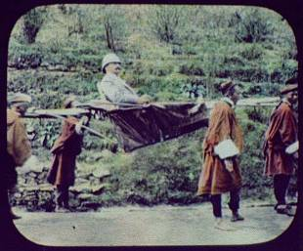
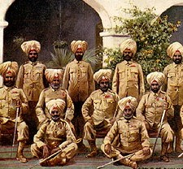
Unrest
Slow progress towards independence between the two world wars
Caused unrest among the Indian people.
The British sometimes reacted with force which resulted in death and the arrest of thousands.

Slide 10
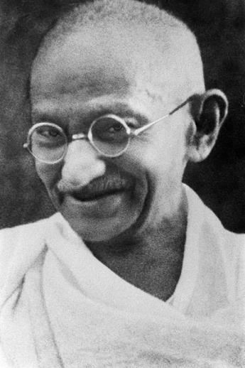
Mohandas Gandhi
Father of modern India
Goal: Indian independence and to remain unified
Non-violence

Slide 11
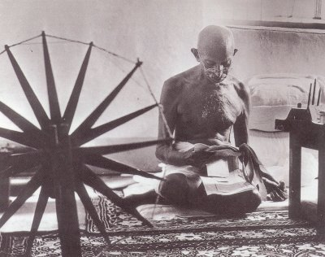
Tactics Used By Gandhi
Boycott of British products
Homespun movement

Slide 12
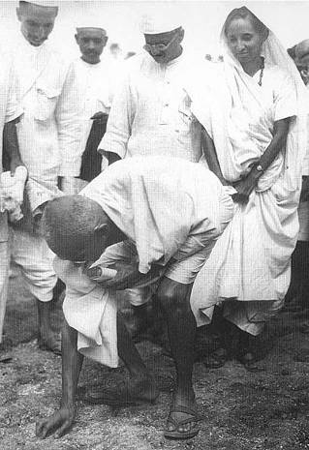
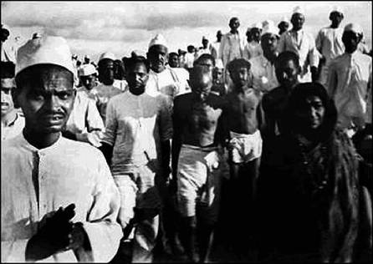
Tactics Used By Gandhi
Salt March in 1930
Defy the British salt tax laws

Slide 13
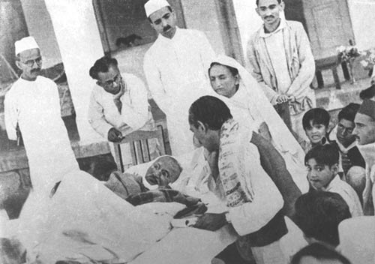
Tactics Used By Gandhi
Fasting
When violence broke out between Hindus and Muslims, Gandhi would not eat until the violence stopped.

Slide 14
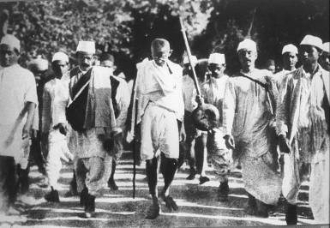
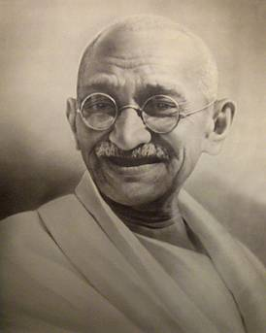
Quotes by Gandhi
“When I despair, I remember that all through history the way of truth and love has always won. There have been tyrants and murderers and for a time they seem invincible, but in the end, they always fall — think of it, always."
"An eye for an eye makes the whole world blind."
“There are many causes that I am prepared to die for, but no causes that I am prepared to kill for."

Slide 15
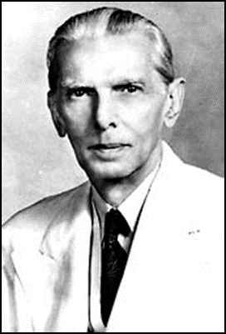
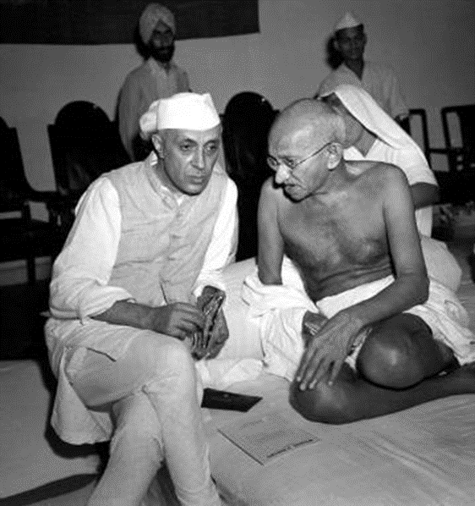
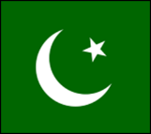
Congress Party
Hindu-dominated
For a unified India
Ghandi & Nehru
Muslim League
Muslim dominated
Wanted separate Muslim state (Pakistan)
Muhammad Ali Jinnah

Slide 16
Impact of WWII
Indians fought for British
British are weak and poor after war
Idea of colonies becomes unpopular

Slide 17
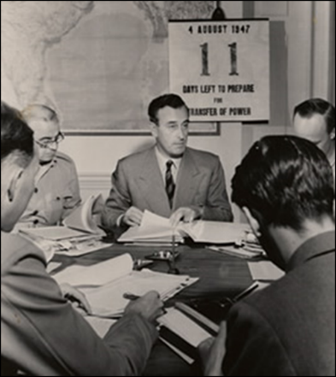
Transfer of Power
Viceroy Lord Mountbatten
Agree to partition
Only 2 months to divide everything up

Slide 18
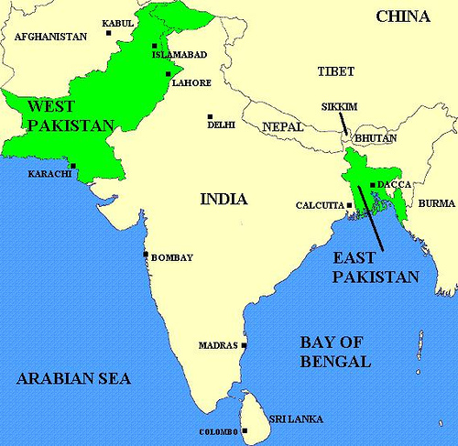

Slide 19
Religions in British India
Pink – Hindu
Green – Muslim
Yellow – Buddhist

Slide 20
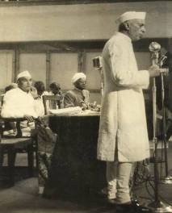
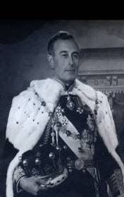
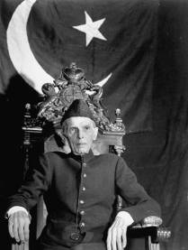
Nehru: Prime Minister of India.
Mountbatten: Governor General of India.
Jinnah: Governor General of Pakistan.

Slide 21
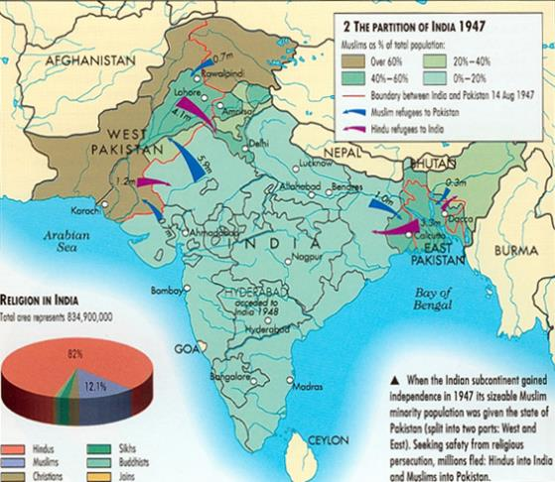
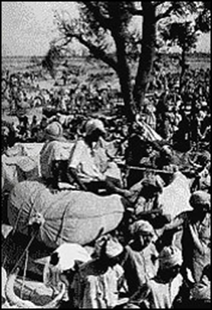
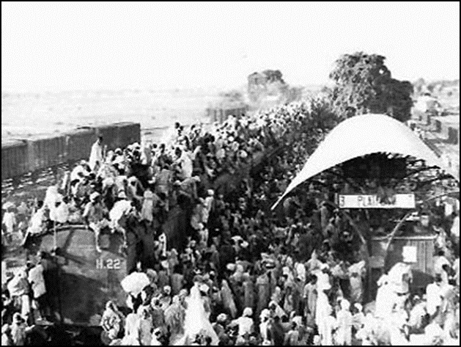
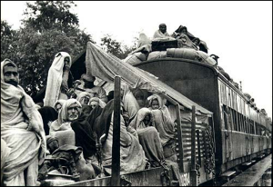

Slide 22
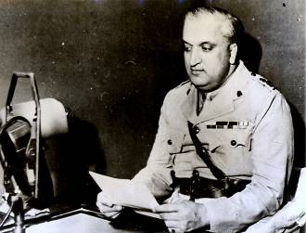
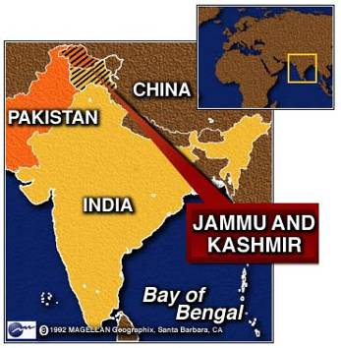
Kashmir
The Maharajah of Kashmir was Hindu. Most of his subjects were Muslim.
The Maharajah wanted Kashmir to remain independent.
Pakistan invades
Maharajah seeks help from India
Forced to join India

Slide 23
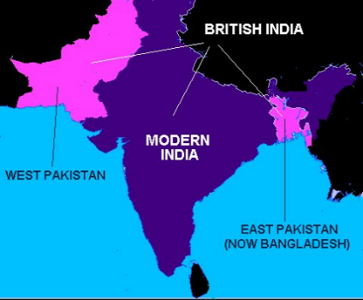
West vs. East Pakistan
One country after partition
Shared Islamic faith, but different ethnic groups and languages
West Pakistan tried to suppress East Pakistan (Bengal) culture and identity
East Pakistan breaks away in 1971 to form Bangladesh

Slide 24
Why do India and Pakistan Hate Each Other?:
https://www.youtube.com/watch?v=yReaR1p-PV0
Kashmir Conflict:
https://www.youtube.com/watch?v=QlI5yArLvLU
Why do Bangladesh and Pakistan Hate Each Other?:
https://www.youtube.com/watch?v=YHfz_U-cXxI

