Slide 1
May 2, 2017
Fall of USSR notes
Get out paper and pencil

Slide 2
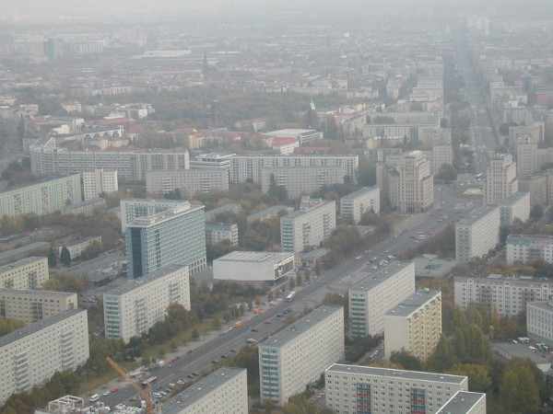
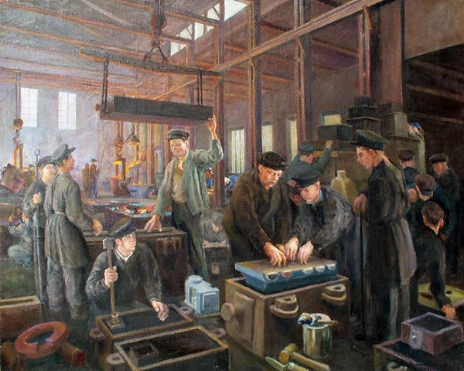
Economy of communist soviet union
Command Economy
Government controlled all aspects of the economy
What to produce, how much, where industries were located
Rapid industrialization
Near zero unemployment rate
High output of industrial goods
Low output of commercial goods
Low standard of living for citizens
Low levels of innovation and quality
Notes:
2

Slide 3
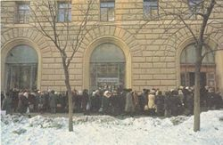
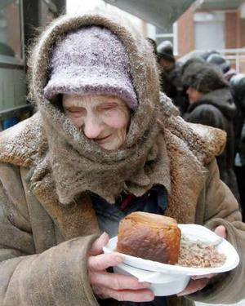
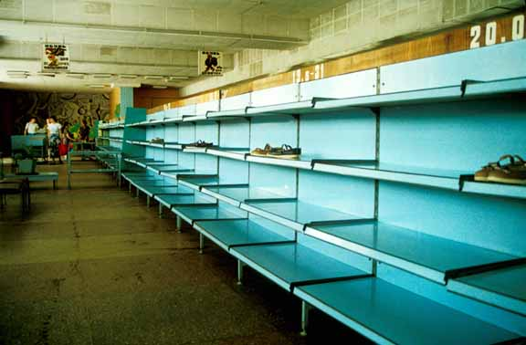
Soviet union after 1970
Food and consumer good shortages
Lack of faith in Communist system
No protests, but apathetic workforce
Moscow residents line up outside a store to buy shoes.
Notes:
3
3

Slide 4
Problems of Soviet Union in 1985
Central planning was inefficient
The factory management system provided little incentive to make technological advancements
The socialist farm system was inefficient – there were poor worker incentives and storage and transportation problems.
High defense spending from Arms Race

Slide 5
Mikhail Gorbachev
Comes to power in March 1985
Introduced five-point policy of reform to meet the needs of the Russian state

Slide 6
Gorbachev's Five-Point Plan
Glasnost (openness) – greater freedom of expression, free speech
Perestroika (economic restructuring) – decentralization of the Soviet economy with gradual free-market reforms
Renunciation of the Brezhnev Doctrine (armed intervention where socialism was threatened) and the pursuit of arms control agreements. Attempts to limit defense spending
Reform of the KGB (secret police service)
Reform of the Communist Party

Slide 7
Policy #1: Glasnost
Freedom of speech and free elections
1989 elections - reformist politicians swept into power
unwittingly unleashed emotions and political feelings that had been pent up for decades

Slide 8
Policy #2: Perestroika
Economic reform and rebuilding (complete economic restructuring)
Private ownership
Workers given the right to strike
Unsuccessful – bureaucratic corruption

Slide 9
Gorbachev’s Response
Does not use military force to put down revolutions in Eastern Europe
Ultimately eroded the power of the Soviet Union during 1989 and 1990.
Each country in the Easter Bloc and U.S.S.R breaks free

Slide 10
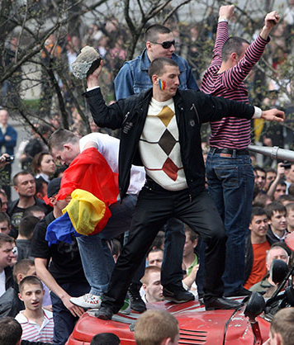
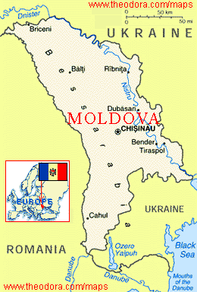
The Rise of Nationalism
Soviet grip relaxes
Discontent with Soviet govt. grows due to lack of food and clothing
Nationalism in the republics surges
Separatist movements threatened the very existence of the Soviet Union.
Protestors in Moldova

Slide 11
August Coup
August 1991 – “hard-line” Communists take over of government
last-ditch effort to save USSR
country went into an uproar; massive protests
soldiers themselves rebelled – “can’t fire on our countrymen”
Coup collapsed after 3 days

Slide 12
Results of August Coup
Gorbachev was unable to reestablish real control
negotiated the transition of power made inevitable by the will of the people.
December 1, 1991 all non-Russian republics declared independence (population wanted democracy)
political movements which had emerged since the implementation of glasnost resulted in immediate fall

Slide 13
Results of the Fall
Transformed the entire world political situation
Reformulation of political, economic and military alliances
End of Cold War and MAD threat
Creation of 24 new independent countries

Slide 14
The Economic Geography of Post-Communist Russia:
Economic Characteristics of
Communist-era Russia:
* No unemployment- the government guaranteed people jobs.
* Free housing, health care, and
college tuition- paid for by the
government.
Economic Characteristics of
Post-communist Russia:
* High unemployment- many industries collapsed due to competition from the West.
* Housing, health care, and college tuition no longer free.
Overall , the standard-of-living decreased for most Russians after the collapse of communism in 1991
Notes:
14

Slide 15
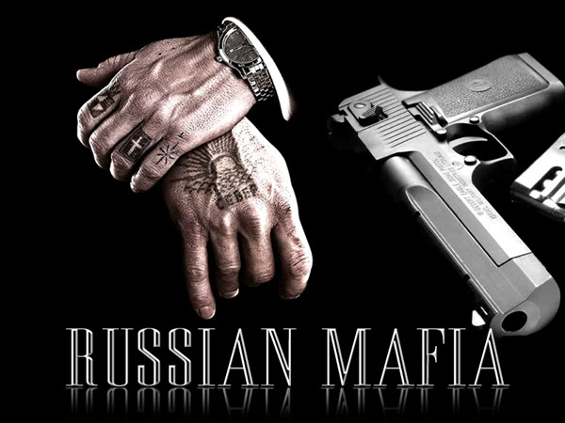
Russia post-cold war
Organized crime (the mafia)
Illegal activities often more profitable
Govt. can’t collect taxes on goods from the Black Market (lose revenue)
Notes:
15

Slide 16
Remaining Communist Countries
At its peak, communism was practiced in dozens of countries:
Soviet Union: Armenia, Azerbaijan, Belarus, Estonia, Georgia, Kazakhstan, Kyrgyzstan, Latvia, Lithuania, Moldova, Russia, Tajikistan, Turkmenistan, Ukraine, and Uzbekistan
Asian Countries: Afghanistan, Vietnam, Cambodia, Mongolia, and Yemen
Soviet Controlled Eastern bloc countries: Bulgaria, Czech Republic, East Germany, Hungary, Poland, Romania, Slovakia.
The Balkans: Albania, Bosnia, Herzegovina, Bulgaria, Croatia, Macedonia, Montenegro, Serbia, and Slovenia.
Africa: Angola, Benin, Congo, Ethiopia, Somalia, Eritrea, and Mozambique.
Currently : Laos, North Korea, Vietnam, China, and Cuba

Slide 17
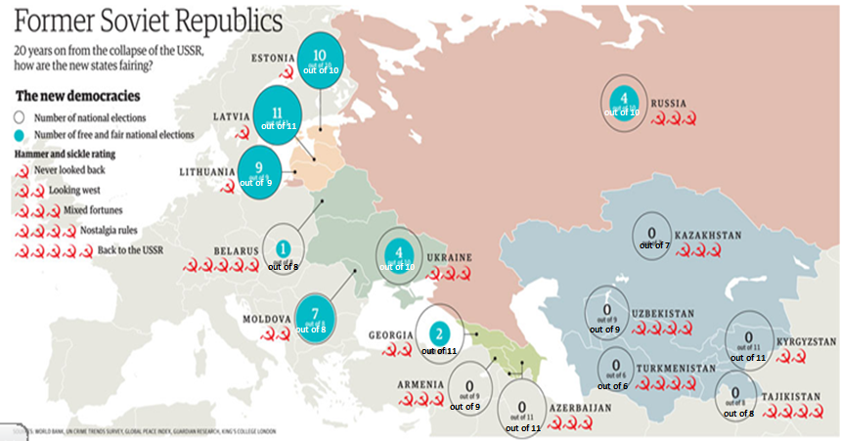

Slide 18
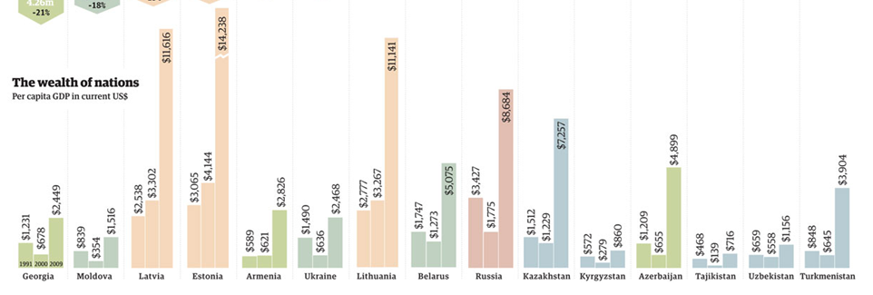

Slide 19
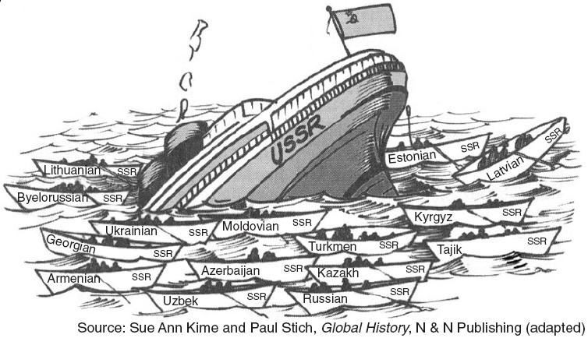

Slide 20
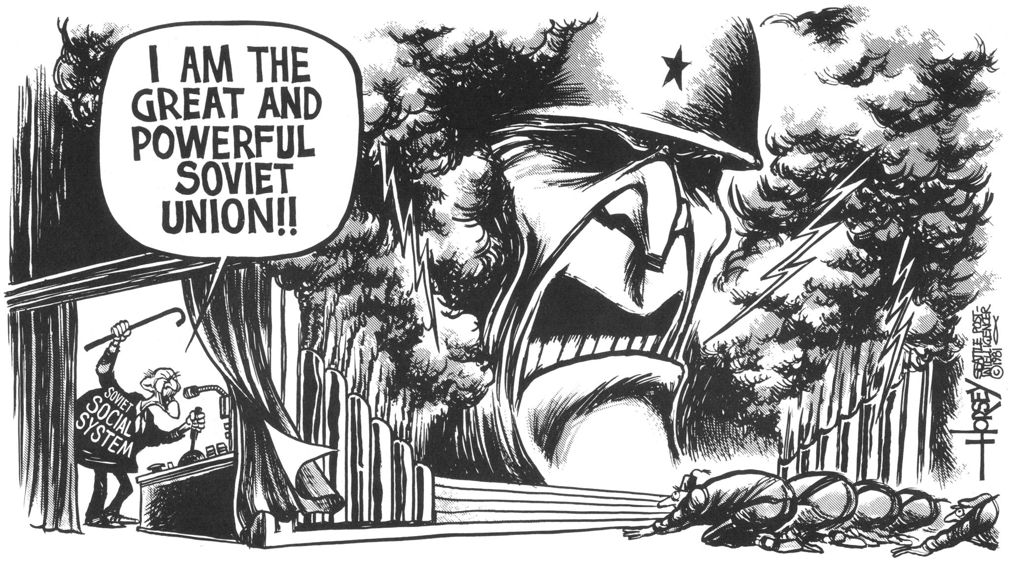

Slide 21
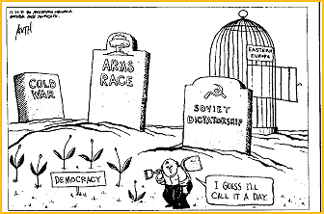

Slide 22
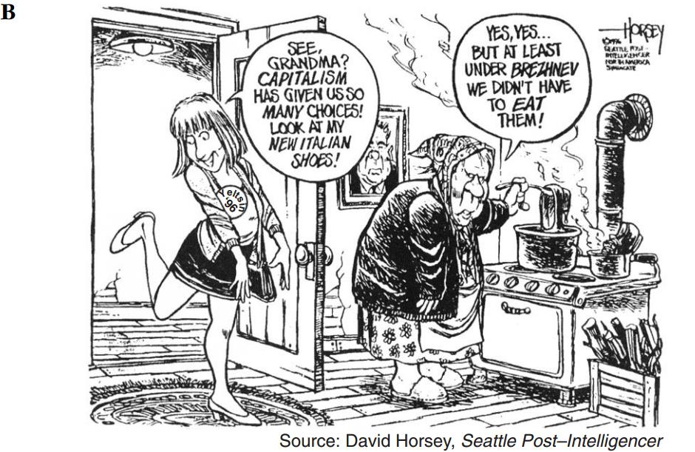

Slide 23
